Slide 1
Introduction to Agile
CHAITANYA R GAAJULA - ALL COPYRIGHTS RESERVED

Slide 2
Overview of Software Development Life Cycle (SDLC)
The Software Development Life Cycle (SDLC) is a well-organized process for building software that guarantees the quality and accuracy of the software created. SDLC process intends to deliver high-quality software that meets client expectations. The system development should be finished in the pre-defined time and cost.
SDLC Benefits:
Provides a framework for a conventional set of projects and deliverables.
Best way for project tracking and administration.
Increases the visibility of project planning to all associated stakeholders.
It helps boost the development speed.
It also improves client relations.
It helps you to reduce project risk and project administration plan overhead.

Slide 3
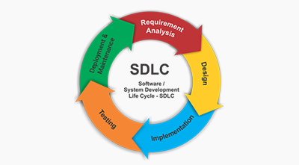
SDLC Phases

Slide 4
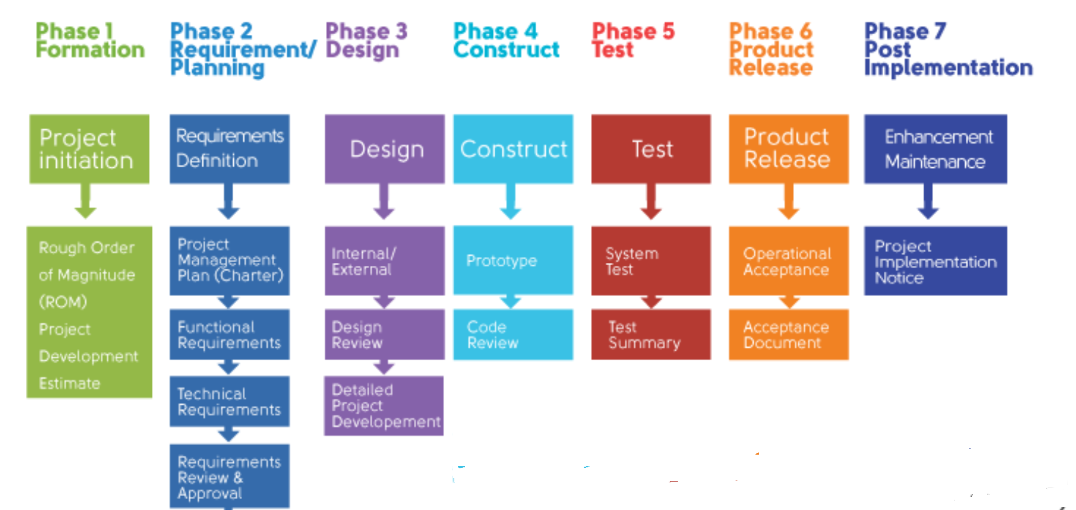
SDLC Flow

Slide 5
SDLC Stages
Stage 1: Planning and Requirement Analysis
Requirement analysis is the most important and fundamental stage in SDLC. It is performed by the senior members of the team with inputs from the customer, the sales department, market surveys and domain experts in the industry. This information is then used to plan the basic project approach and to conduct product feasibility study in the economical, operational and technical areas.
Stage 2: Design Approach
Based on the requirements , usually more than one design approach for the product architecture is proposed and documented in a DDS - Design Document Specification.
This DDS is reviewed by all the important stakeholders and based on various parameters as risk assessment, product robustness, design modularity, budget and time constraints, the best design approach is selected for the product.
A design approach clearly defines all the architectural modules of the product along with its communication and data flow representation with the external and third party modules (if any). The internal design of all the modules of the proposed architecture should be clearly defined with the minutest of the details in DDS.

Slide 6
SDLC Stages
Stage 3: Building or Developing the Product
In this stage of SDLC the actual development starts and the product is built. The programming code is generated as per DDS during this stage. If the design is performed in a detailed and organized manner, code generation can be accomplished without much hassle.
Developers must follow the coding guidelines defined by their organization and programming tools like compilers, interpreters, debuggers, etc. are used to generate the code. Different high level programming languages such as C, C++, Pascal, Java and PHP are used for coding. The programming language is chosen with respect to the type of software being developed.
Stage 4: Testing the Product
This stage is usually a subset of all the stages as in the modern SDLC models, the testing activities are mostly involved in all the stages of SDLC. However, this stage refers to the testing only stage of the product where product defects are reported, tracked, fixed and retested, until the product reaches the quality standards defined in the SRS.

Slide 7
SDLC Stages
Stage 5: Deployment and Maintenance
Once the product is tested and ready to be deployed it is released formally in the appropriate market. Sometimes product deployment happens in stages as per the business strategy of that organization. The product may first be released in a limited segment and tested in the real business environment (UAT- User acceptance testing).
Then based on the feedback, the product may be released as it is or with suggested enhancements in the targeting market segment. After the product is released in the market, its maintenance is done for the existing customer base.

Slide 8
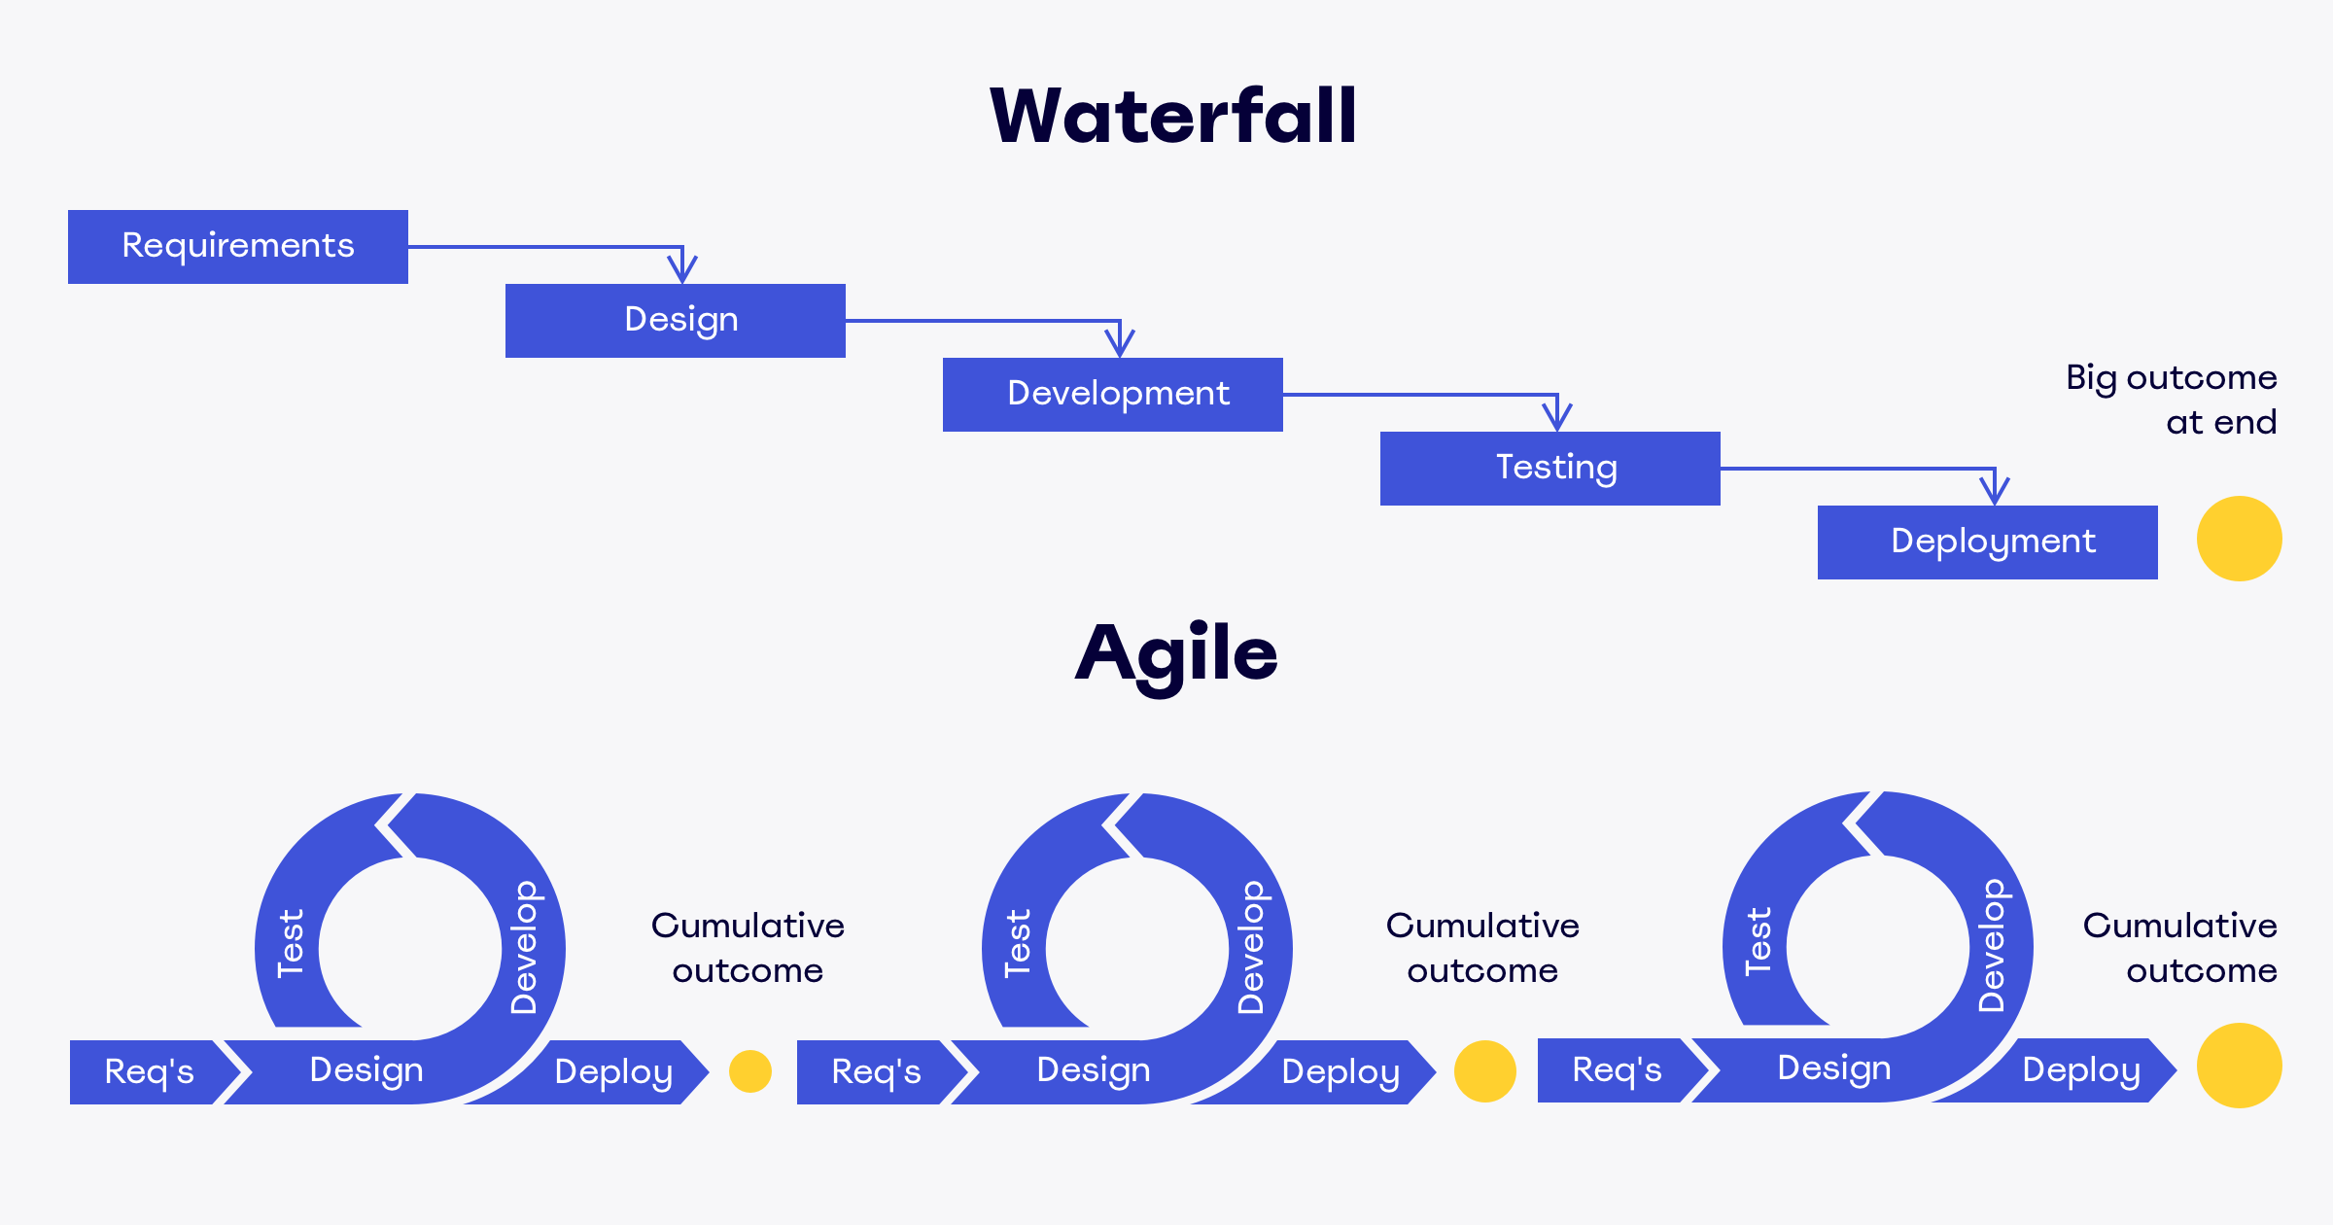
Software Development Life Cycle Models
Waterfall
Lean
Agile
DevOps

Slide 9
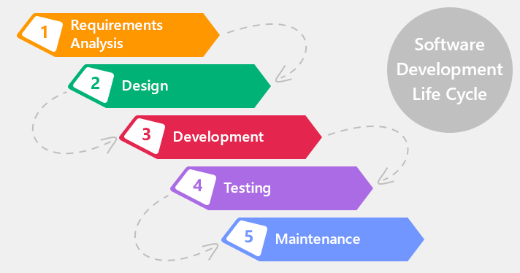
Waterfall Model

Slide 10
Disadvantages of Waterfall Model
Short of flexibility
Lack of visibility of the current progress
Increased delivery term
Changes in the business requirements or new additions in functionality require changes at all previous steps
Time-shift in one phase will strongly affect the whole road map as simultaneous processes are not available in a waterfall model
The end product is available only at the end of a cycle

Slide 11
LEAN Management
Lean management is a popular approach to run a company based on the concept of continuous improvement. In other words, it is an ongoing effort to refine products, services, or processes, which require “incremental” improvement over time in order to increase efficiency and quality.
The main purpose of lean management is to reduce factors that waste time, effort or money. The only way to manage with it is to analyze a business process and then revise it and cut out every step that does not create value for customers.
The Lean methodology relies on 3 very simple ideas:
Deliver value from your customer’s perspective
Eliminate waste (things that don’t bring value to the end product)
Continuous improvement

Slide 12
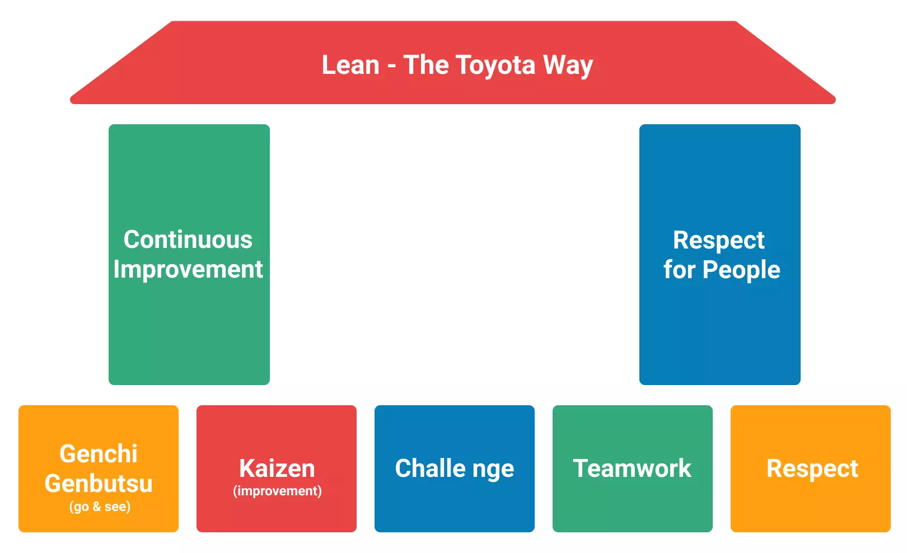
Main Pillars of Lean Methodology

Slide 13
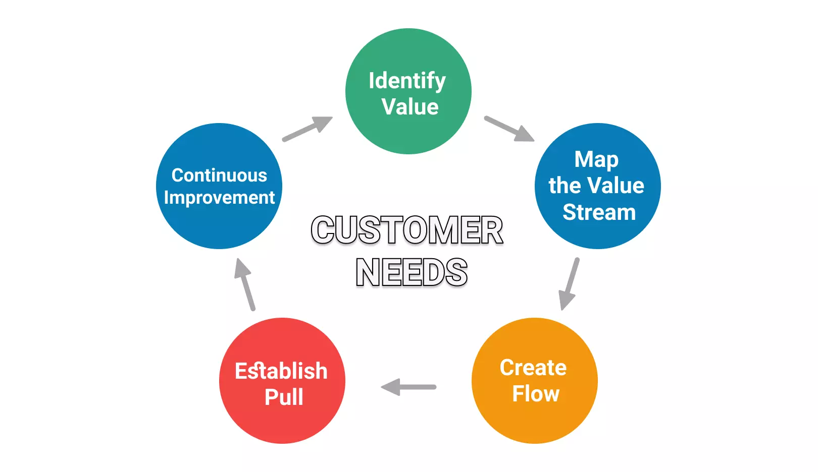
LEAN Principles

Slide 14
Benefits of LEAN Management
Focus. By applying the Lean methodology, you will be able to reduce waste activities. Therefore, your workforce will be focused on activities that bring value.
Improving productivity & efficiency. When employees are focused on delivering value, they will be more productive and efficient because they won’t be distracted by unclear tasks.
Smarter process (pull system). By establishing a pull system, you will able to deliver work only if there is actual demand. This leads to the next one.
Better use of resources. When your production is based on actual demand, you will be able to use only as many resources as needed.

Slide 15
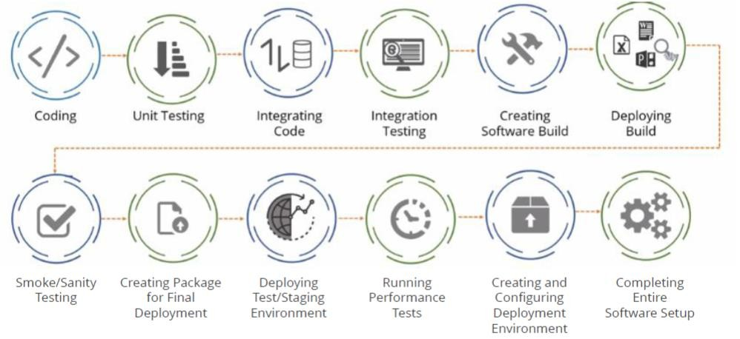
AGILE Model

Slide 16
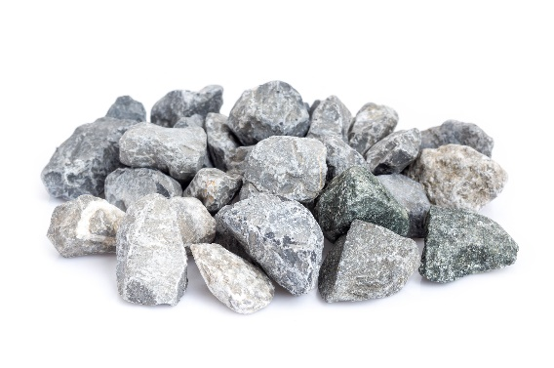

What is Agile?
Agile is a method used to manage a large project
It divides the large project into small and manageable chunks, which are known as iterations
Incrementally
Instead of all at once

Slide 17
The Attributes of Agile
Agile
Cooperative
Adaptable
Quality-driven
Rapid
Iterative
Agile is not a process, it is a set of values.

Slide 18

Producing Value
Some value is produced at the end of every iteration, which usually takes place over a continuous time interval
This product enables the business to gain feedback from the users or stakeholders

Slide 19
Characteristics of Agile
Simple design
Small to medium-sized teams
Vague and changing techniques
Minimal system of production
Vague and changing requirements
Light weighted and methodological

Slide 20
Agile
Agile methods develop a disciplined Project Management process that promotes frequent inspection and adaptation
Leadership philosophy encourages:
Teamwork
Self-organisation
Accountability
A set of engineering best practices
Designed to allow prompt delivery of high-quality software, and a business approach that coordinates development with the requirements of customer-company goals
Notes:
In February2001, the Manifesto was developed by a group fourteen leading figures in the software industry, and reflects their experience of what approaches do and do not work for software development.

Slide 21

Agile, the Agile Manifesto
There are 4 fundamental values that comprise the Agile Manifesto, as well as 12 principles that guide the approach to Agile software development
All Agile methodologies relate to the 4 values differently, however all of them require the development and production of excellent software functions

Slide 22
The 4 Values of the Agile Manifesto
Individuals and interactions over processes and tools
Working software over comprehensive documentation
Customer collaboration over contract negotiation
Responding to change over following a plan

Slide 23
Principles of Agile
Highest priority is customer satisfaction, achieved by the early and continuous delivery of valuable software
Welcome the changing requirements, even those that arise late in development
Working software is frequently delivered, from a couple of weeks or months, preference to the shorter timescale
Throughout the project, the business people and developers must work together

Slide 24
Principles of Agile
Projects are built around motivated individuals - support and trust them to get the job done
Face-to-face conversation is the most efficient and effective method of conveying information
The working software is the principal measure of progress
Agile processes promote sustainable development, the ability to maintain a constant pace

Slide 25

Principles of Agile
Good design and continuous attention to technical excellence enhances agility
Simplicity and the art of maximising the work amount not done is essential
Requirements, best architecture, and design emerge from all self-organising teams
Frequently reflect on how to improve efficiency

Slide 26

Benefits of Agile
Risk Management
Quality
Flexibility
Right Product
Cost Control
Transparency
Speed to market
Notes:
Risk Management:
Incremental releases means that the product can be used early in the process by stakeholders and users. This lets you identify issues and feature deficits early in the process. Being adaptable to change means it isn’t a problem to change the scope midway through the project, something that would be impossible in a waterfall style project.
Quality
Agile integrates testing throughout the process. Consistently delivering tested software means higher overall quality and less time spent on QAing the full application.
Flexibility
Agile is based on accommodating change. Software projects consistently change. As a product comes to life or the market expands, you should be able to react and update the product accordingly. Agile also realizes that great ideas are bound to come mid-project and being locked into a scope doesn’t let you take advantage of these realizations.
Right Product
Incremental releases let you test your product early and often. Even if you don’t release it to the public, it’s much easier to locate flaws and things that can be improved when you have an actual product to play with vs a series of designs.

Slide 27
Agile Concepts and Methodologies of Agile

Slide 28

Agile Concepts
The core ideas in Agile:
Adaptive: The process and the team must be flexible
Iterative: Agile Development introduces efficient products in stages, which are evolving sets of “completed and working software”
People-oriented: The organisation should support teams and people as they are an essential element for the success of a project
FDD
Lean
DSDM
Scrum
Crystal
XP
Kanban
ASD

Slide 29
Agile Practices

Slide 30
Methodologies of Agile
Agile methodology encourages the continuous iteration of advancement and testing during the project software development life cycle
Following are some Agile methodologies that can be implemented within Agile projects:
1. Scrum
2. Kanban

Slide 31
Thank You

